Slide 1


Agentic Design:
From Brand to Production
KAUST Summer
Prepared By: Turki Alshuaibi

Slide 2
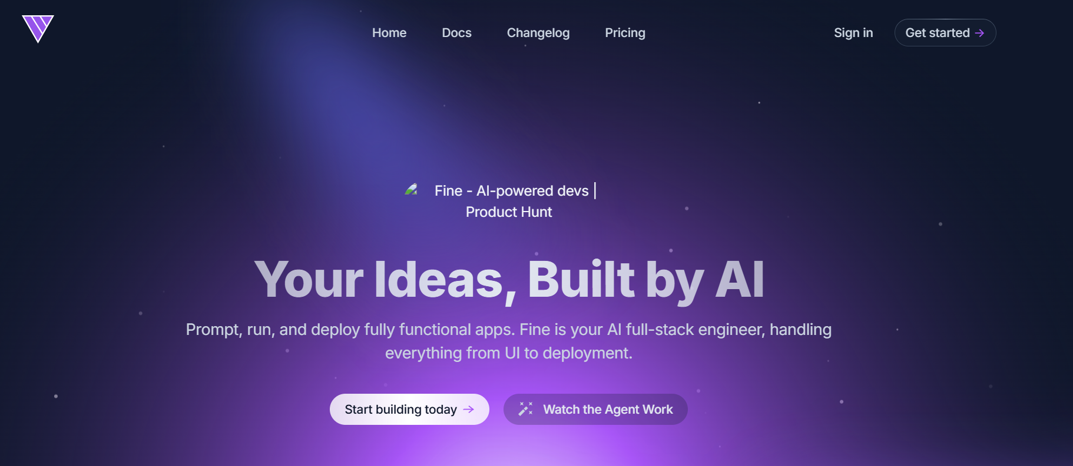
You Have Seen This Website Before
The default AI startup page
• Purple gradients everywhere • Glass cards and floating icons • Generic startup copy • Looks clean for 10 seconds • Could belong to any company
The agent did not fail.
The direction was empty.

Slide 3
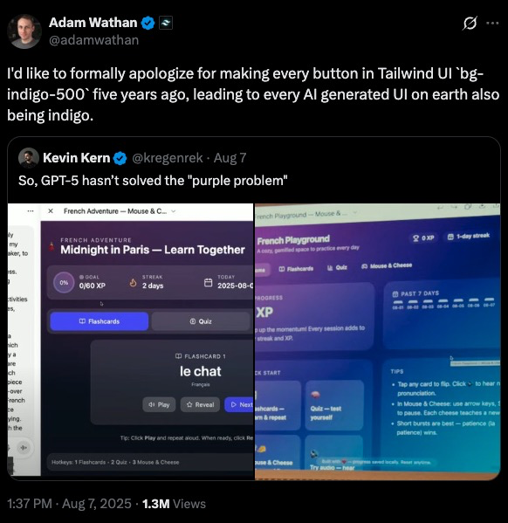
Backstory: The Purple Site, and a Jump to some Designs
Use it as the running case study

Slide 4
What Agentic Design Actually Means
Not one prompt. A managed production loop.
Agentic design is the practice of directing AI agents through context, constraints, references, tools, and review loops to produce intentional digital experiences.
The agent builds. You decide.
📄
Context
🧰
Tools
🔁
Feedback
4
Files that define product, brand, codebase, and constraints.
Coding, browser, image, video, deployment, and QA agents.
Rendered screenshots, diffs, tests, and human judgment.
Intent, Taste, Risk, Approval
Sources: OpenAI Agents SDK docs; Google Antigravity overview

Slide 5





Tool Map + The Harness
Different agents, different failure modes.
Codex
Claude Code
Antigravity
Codebase work, diffs, tasks, tests
Project memory, planning, execution
Agent-first coding surface, terminal, browser
🌐
Higgsfield
Browser tools
GitHub
Image, video, brandkit, visual skills
Rendering, screenshots, QA walkthroughs
Review, branches, rollback, collaboration
Sources: OpenAI Codex docs; Anthropic Claude Code docs; Google Antigravity; Higgsfield Skills

Slide 6
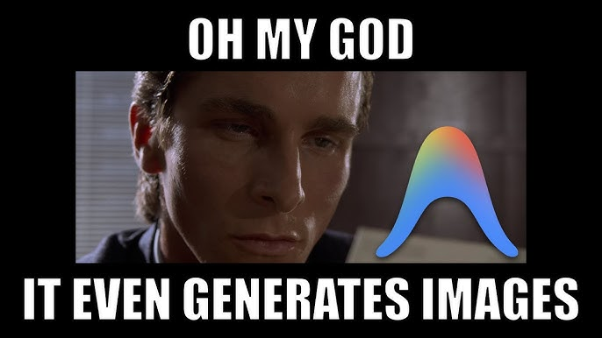
Antigravity is the enemy!
A reported Antigravity incident involved deleting an entire drive while clearing cache. Source: TechRadar, Incident Database, Google Antigravity docs.

Slide 7
Commit Before You Prompt
Versioning is the first design tool.
git init
git add .
git commit -m "chore: baseline before agent"
git branch -M main
git remote add origin <repo-url>
git push -u origin main
• Git does not stop deletion. It lets you recover committed work. • Uncommitted files can still disappear. • Ignored uploads, local databases, and secrets need backups. • Use branches before large agent changes. • Review the diff before you accept the work.
Git is the save system for agentic work.

Slide 8
The Backstory of the Brand
Do not begin brand.md with colors.
• Why does the brand exist? • What problem made it necessary? • Who should feel understood by it? • What emotion should it create? • What does it refuse to become?
”I am the brand guidelines.”
- Turki Alshauibi
# Brand Story
Created because technical work often feels
generic, loud, and forgettable.
The brand should feel precise, calm,
credible, and human.
It must not resemble a generic AI
startup, crypto product, or neon demo.
The story gives the agent reasons, not just preferences.

Slide 9
brand.md as a Creative Constitution
Reusable context beats repeated prompting.
# Brand
# Story
# Audience
# Positioning
# Personality
# Voice
# Visual principles
# Typography
# Color system
# Logo rules
# Motion
# Anti-patterns
# Approved references
# Prohibited references
The best section:
Anti-patterns
• Do not default to purple gradients • Do not invent testimonials or metrics • Do not center every section • Do not decorate without meaning
Positive rules guide. Negative rules prevent fallback.

Slide 10
The Context Stack
Separate what, why, and how.
1
product.md
2
brand.md
3
AGENTS.md
4
CLAUDE.md
What are we building? Audience, pages, proof, user journey.
What should it feel like? Story, tone, visuals, anti-patterns.
How should the agent work? Commands, tests, limits, definition of done.
Project memory and conventions for Claude Code sessions.
Files make taste portable across sessions and tools.
Sources: AGENTS.md specification; Anthropic Claude Code memory guidance.

Slide 11
Turn Brand Into Tokens
Do not ask the agent to remember consistency. Encode it.
:root {
--color-background: #000000;
--color-surface: #111318;
--color-text-primary: #ffffff;
--color-text-secondary: #a7a7a7;
--color-accent: #008bd2;
--color-warning: #fdb515;
--radius-sm: 0.375rem;
--radius-md: 0.75rem;
--space-4: 1rem;
--space-8: 2rem;
}
background
surface
text
accent
warning
success
Tokens make the brand executable.

Slide 12
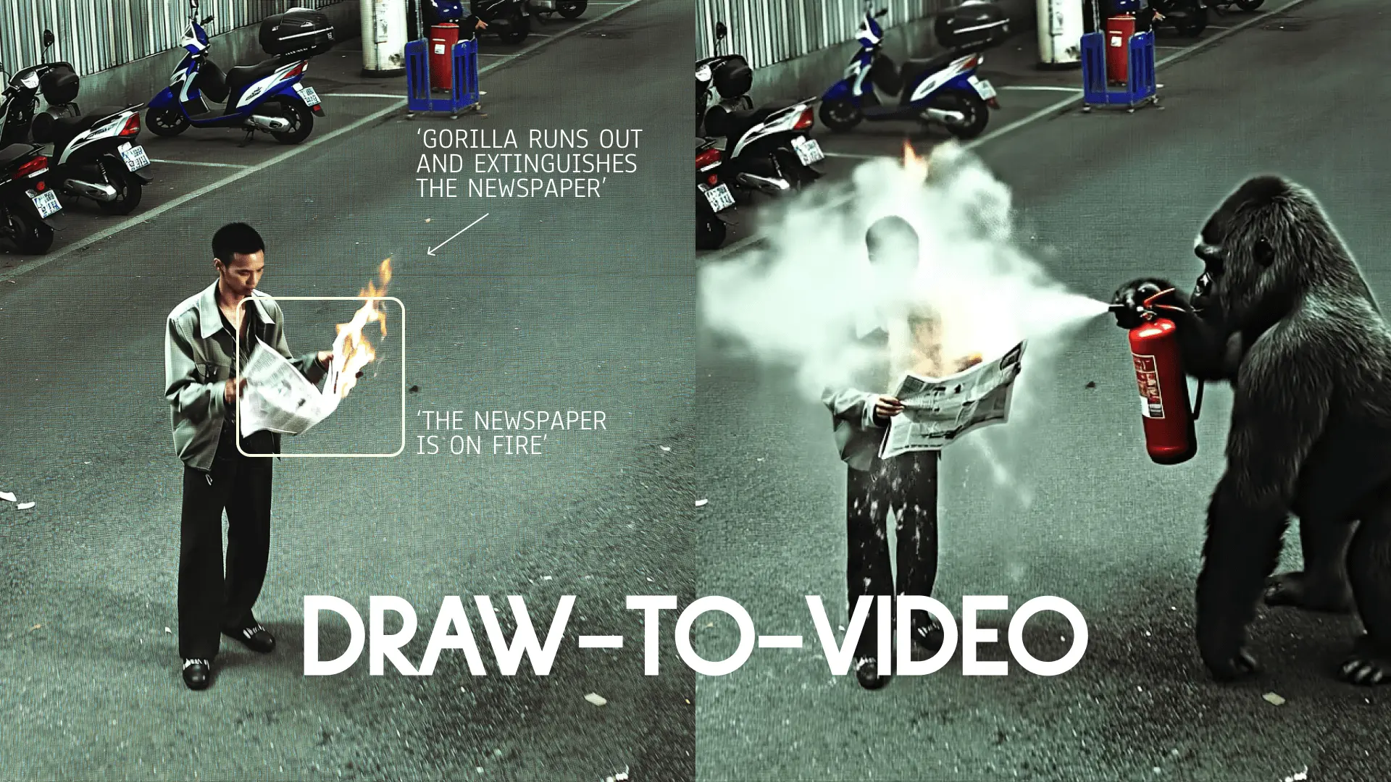



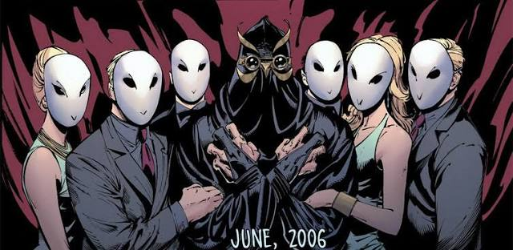
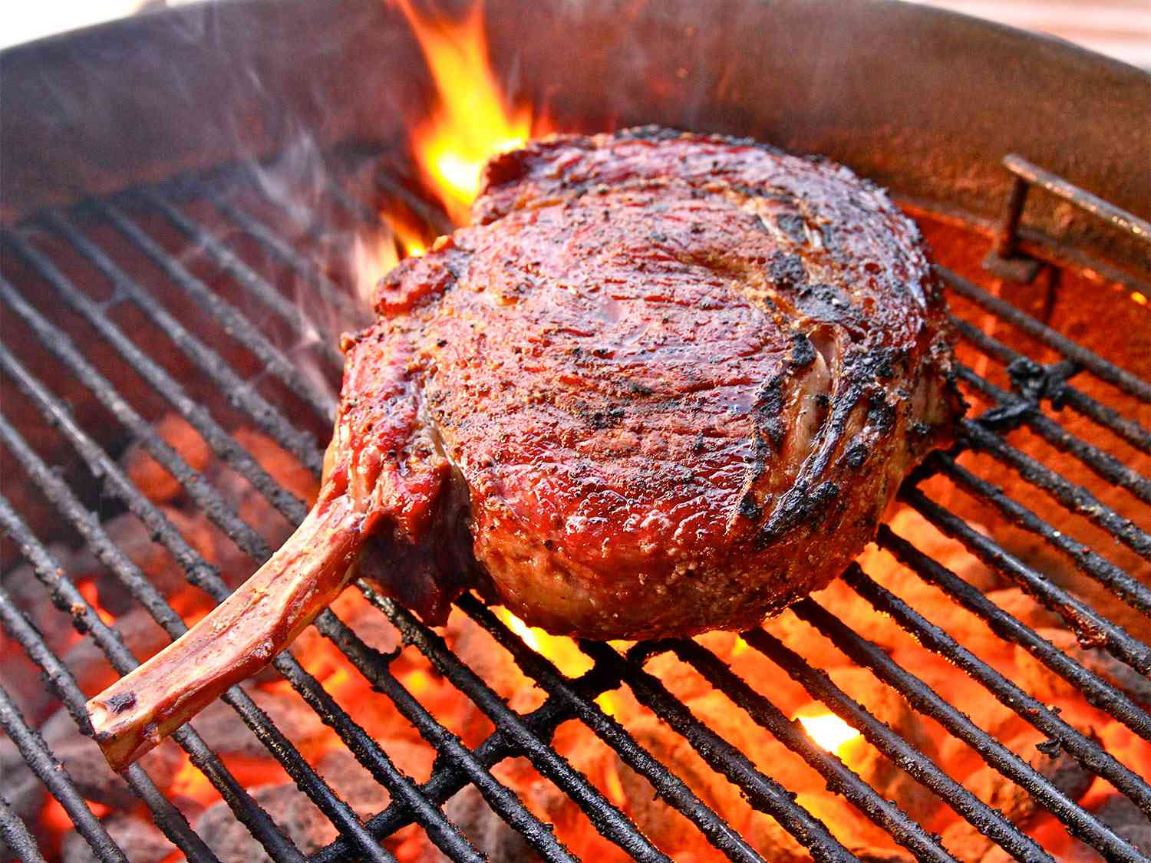
Skills and MCPs
Move from web page generation to full creative production.
🎥
Generate
Higgsfield MCP: Images, videos, 3D, audio, and branded ad modes.
Open-source AI toolkit for professional, accessible UI/UX design.
critique, polish, typography, color, motion, responsive behavior, accessibility, and removing common AI design
🎨
Ponytail
🌐
Call the council
🎙
Grill Me
Lazy dev in room
Summons a council to replicate LLM council
Grills, make sure idea are good
“A person’s mind can sometimes create a more real world than reality itself.”
- CG Chapter 5
Sources: Higgsfield Skills page and higgsfield-ai/skills GitHub README.

Slide 13
Logos Are Systems, Not PNGs
Use SVG so brand assets stay editable and color-aware.
• Resolution independent • Small for simple marks • Editable paths • CSS-controlled colors • Light and dark variants • Reusable in favicon, nav, deck, and social assets
<svg viewBox="0 0 64 64">
<path d="..." fill="currentColor" />
</svg>
.logo {
color: var(--color-text-primary);
}
.logo-on-dark {
color: white;
}
Inline SVG can inherit currentColor. An SVG loaded with img usually cannot.

Slide 14

Favicon and Logo Details
Small identity needs separate design judgment.
• Remove fine details • Increase negative space • Test dark and light browser chrome • Create apple-touch-icon separately • Use social preview image, not favicon, for sharing
H
16×16 test
<link rel="icon" href="/favicon.svg" type="image/svg+xml">
<link rel="icon" href="/favicon.ico" sizes="any">
<link rel="apple-touch-icon" href="/apple-touch-icon.png">
<link rel="manifest" href="/site.webmanifest">

Slide 15
SEO, AEO, and Metadata
AEO is not magic metadata.
• Unique titles and descriptions • Semantic headings • Descriptive URLs • Canonical URLs • Structured data that matches visible content • Sitemap and robots directives • Clear answers to real questions • Original proof and expertise
Social card preview
Agentic Design: From Brand to Production
How to direct AI agents to build branded, production-ready digital experiences.
turkialshuaibi.com
<meta property="og:title" content="...">
<meta property="og:image" content="/og.png">
<meta name="twitter:card" content="summary_large_image">
Sources: Google Search Central AI features guidance; Google structured data docs; web.dev metadata guidance.

Slide 16
How Not to Look Vibe Coded
Ask the agent to defend the design choices.
Ban the defaults
Demand evidence
✕ No generic startup copy ✕ No fake metrics or clients ✕ No random decorative icons ✕ No gradient as personality ✕ No identical three-card sections
✅ What is unique to this brand? ✅ Which section proves trust? ✅ What changed after screenshot review? ✅ What does mobile prioritize? ✅ What should be removed?

Slide 17
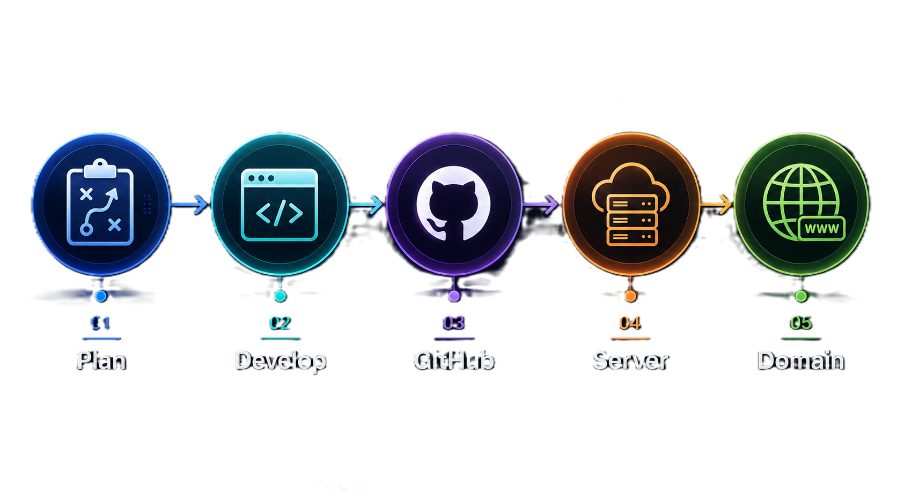
The final flow
(Github pages, Vercel, server…)

Slide 18
From Purple Demo to Real Product
The visible transformation.
Before
After
Generic prompt
Generic visuals
Generic copy
Generic metadata
Brand story
Design tokens
Visual skills
SEO and QA
Looks like everything else.
Looks like it belongs to one brand.
“Steal like an Artist”

Slide 19
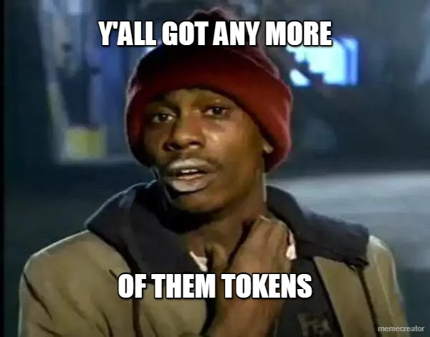

Slide 20
Thanks for Attending!
The agent builds. You decide.
Prepared By: Turki Alshuaibi

Slide 21
Some Gifts 🎁
Main Gift
https://drive.google.com/file/d/1P-d5zBRd7P3BOjxzpGsK-rGr7UKpCeQh/view?usp=share_link
Inspiration https://godly.website https://mobbin.com https://dribbble.com https://land-book.com
UI Components https://21st.dev https://ui.shadcn.com https://magicui.design https://ui.aceternity.com https://reactbits.dev
Assets https://lucide.dev https://www.fontshare.com https://lottiefiles.com https://spline.design
AI / Creative https://higgsfield.ai https://coolors.co
Agent Pack Templates • Skills • brand.md • Prompts • Starter Files

